Slide 1

DAY 1
SQL Essentials
Querying, Analyzing, and Investigating Transaction Data with SQL + DuckDB
Faisal Goussous · August 2026

Slide 2
CLASS INTRODUCTION
Class Introduction
Your name, group/department, and what you do day-to-day.
One thing you hope to get from this course.
30 seconds each
SQL ESSENTIALS · DAY 1
2

Slide 3

ABOUT THE INSTRUCTOR
About the Instructor – Faisal Goussous
Faisal Goussous — data & analytics specialist, 15+ years across aviation, healthcare, and insurance.
Analytics Partner at Taha Actuaries and Consultants (Dubai) and Iktimal Data Solutions - risk scoring & pricing models for insurance portfolios covering hundreds of thousands of members.
12+ years in the US: Senior Research Engineer at GE Aviation (modeling aircraft sensor data, U.S. patent) and software engineer at Rockwell Collins.
MSc & BSc in Electrical & Computer Engineering (First Class Honors) — University of Iowa & University of Jordan; published author.
Delivers hands-on data engineering, visualization and data governance training for analysts, actuaries, and business leaders.
LinkedIn: https://www.linkedin.com/in/faisal-goussous/
Email: faisal@tahaconsulting.com
SQL ESSENTIALS · DAY 1
3

Slide 4
COURSE OVERVIEW
Day 1
1
Setup — GitHub, Codespaces, DuckDB, the datasets
2
SQL fundamentals — SELECT, WHERE, GROUP BY, CASE WHEN
3
JOINs — and the mistakes that quietly corrupt your results
4
CTEs — writing multi-step queries that read cleanly
5
Bonus: self-joins — tracing a chain of transactions
6
Bulk Loading Files into DuckDB
SQL ESSENTIALS · DAY 1
4

Slide 5
COURSE OVERVIEW
Day 2
1
Python refresher — data types, functions, loops (quick!)
2
Modularity & classes — building Transaction class
3
Inheritance, access control & composition
4
Decorators — @timer, @log_call
5
Version Control with Github
6
First risk_utils code
SQL ESSENTIALS · DAY 1
5

Slide 6
COURSE OVERVIEW
Day 3
1
Validate & audit — schema checks, Z-score outliers, @log_risk_event
2
Package, version, and install risk_utils
3
Advanced Topics: Design Patterns, CI/CD, Github Actions
4
Document, test, and merge to main
SQL ESSENTIALS · DAY 1
6

Slide 7
COURSE SETUP
GitHub
GitHub hosts Git repositories in the cloud — version control for code and files.
Benefit for this course: one link gets everyone the exact same starting materials; every change is tracked; nothing is ever truly lost.
Beyond this course: it's the industry-standard way teams collaborate on code — a transferable skill, not just course logistics.
SQL ESSENTIALS · DAY 1
7

Slide 8
COURSE SETUP
Codespaces
A Codespace is a full dev environment (VS Code + tools) that runs in the cloud and opens in your browser — tied to a GitHub repo.
Nothing to install locally, everyone has an identical environment, and it's disposable — break something, just rebuild it.
You can start, stop, and resume a Codespace; it doesn't keep running (and costing time) when you're not using it.
SQL ESSENTIALS · DAY 1
8

Slide 9
COURSE SETUP
DuckDB and the Datasets
DuckDB: an in-process analytical SQL database — “SQLite for analytics.” No server to install; it queries CSV/Parquet files directly.
transactions — the IBM AML synthetic dataset: timestamps, sending/receiving bank + account, amounts, currencies, payment format, is_laundering flag.
accounts — a lookup table mapping numeric bank/account IDs to human-readable bank_name and entity_name, joined all day on bank_id + account_number.
SQL ESSENTIALS · DAY 1
9

Slide 10
PRACTICAL 1
Launch Codespaces
WRITE
-- 1. Launch the Codespace, tour VS Code + the SQL notebook
SELECT * FROM transactions LIMIT 10;
-- Make a small edit (LIMIT 10 -> LIMIT 20)
CHALLENGE
Confirm your clean transactions and accounts views both return rows before moving on.
SQL ESSENTIALS · DAY 1
10

Slide 11
SQL INTRODUCTION
What is SQL
Structured Query Language — a declarative language for tabular data: you describe what you want, not the steps to get it.
Standardized since the mid-1980s, in continuous use for 40+ years.
It's endured because the relational model fits how businesses structure data, and because every major database speaks it — the skill transfers.
SQL ESSENTIALS · DAY 1
11

Slide 12
SQL INTRODUCTION
SQL vs Excel
 | Excel | SQL / Database
Speed at scale | Slows down well before a million rows | Handles millions–billions of rows
Concurrency | One file, easy to lock/conflict | Many people query the same data safely at once
Transactions | Manual save, easy to overwrite by accident | All-or-nothing updates, built-in safety
Reproducibility | Re-click the same steps by hand | Rerun the same script, get the same result
Audit trail | Clicks aren't logged | The query itself is a readable record of what was done
SQL ESSENTIALS · DAY 1
12

Slide 13
SQL INTRODUCTION
Dialects and Databases
Every major database has its own SQL “dialect”: Oracle, SQL Server, PostgreSQL, MySQL, Snowflake, BigQuery, DuckDB, and others.
Core syntax — SELECT, WHERE, JOIN, GROUP BY — is essentially identical everywhere; differences show up in the edges (dates, strings, LIMIT vs TOP).
This course teaches portable, generic ANSI SQL. DuckDB is just our sandbox — what you learn transfers directly to whatever your bank runs.
SQL ESSENTIALS · DAY 1
13

Slide 14
SQL BASICS
SELECT
SELECT column1, column2 FROM table_name;
SELECT * FROM transactions LIMIT 10;
SELECT from_bank, to_bank, amount_paid
FROM transactions
LIMIT 10;
-- SELECT * is great for exploring; name your columns
-- explicitly once you know what you need
SQL ESSENTIALS · DAY 1
14

Slide 15
SQL BASICS
Counting
SELECT COUNT(*) FROM transactions; -- total rows
SELECT COUNT(*) FROM transactions
WHERE is_laundering = 1; -- subset count
-- COUNT(*) counts rows; COUNT(column) counts non-NULL values
-- in that column - these can give different answers
SQL ESSENTIALS · DAY 1
15

Slide 16
SQL BASICS
DISTINCT
SELECT DISTINCT payment_currency FROM transactions
ORDER BY payment_currency;
SELECT COUNT(DISTINCT payment_currency) FROM transactions;
-- "how many different currencies show up in this dataset?"
-- run it live, count the result
SQL ESSENTIALS · DAY 1
16

Slide 17
SQL BASICS
INSERT & DELETE
INSERT INTO table_name (col1, col2) VALUES (val1, val2);
DELETE FROM table_name WHERE condition;
-- this course is read/analyze (OLAP), not modify (OLTP) -
-- as an analyst you'll rarely run these against production
-- banking data. Good to recognize; not a focus today.
SQL ESSENTIALS · DAY 1
17

Slide 18
SQL BASICS
Slicing with WHERE
SELECT * FROM transactions
WHERE is_laundering = 1;
SELECT * FROM transactions
WHERE amount_paid > 10000
AND payment_currency = 'US Dollar';
SELECT * FROM transactions
WHERE payment_format IN ('Wire', 'ACH');
SQL ESSENTIALS · DAY 1
18

Slide 19
SQL BASICS
GROUP BY & Aggregation (Part 1)
SELECT payment_currency, COUNT(*) AS txn_count
FROM transactions
GROUP BY payment_currency;
SELECT payment_currency, SUM(amount_paid) AS total_paid
FROM transactions
GROUP BY payment_currency
ORDER BY total_paid DESC;
-- collapses same-value rows into one, paired with an
-- aggregate: COUNT / SUM / AVG / MIN / MAX
SQL ESSENTIALS · DAY 1
19

Slide 20
SQL BASICS
GROUP BY & Aggregation (Part 2)
-- multiple grouping columns
SELECT payment_currency, payment_format, COUNT(*) AS txn_count
FROM transactions
GROUP BY payment_currency, payment_format;
-- HAVING filters groups AFTER aggregation (WHERE = BEFORE)
SELECT payment_currency, COUNT(*) AS txn_count
FROM transactions
GROUP BY payment_currency
HAVING COUNT(*) > 1000;
SQL ESSENTIALS · DAY 1
20

Slide 21
PRACTICAL 2
Query the Data — Exercise 1
WRITE
SELECT * FROM transactions
WHERE is_laundering = 1
LIMIT 20;
CHALLENGE
Modify it to find laundering transactions over $50,000.
SQL ESSENTIALS · DAY 1
21

Slide 22
PRACTICAL 2
Query the Data — Exercise 2
WRITE
SELECT payment_currency, COUNT(*) AS txn_count
FROM transactions
GROUP BY payment_currency
ORDER BY txn_count DESC;
CHALLENGE
Find the top 3 currencies by total amount paid (SUM), not transaction count.
SQL ESSENTIALS · DAY 1
22

Slide 23
PRACTICAL 2
Query the Data — Exercise 3
WRITE
SELECT DISTINCT payment_format FROM transactions;
CHALLENGE
For each payment_format, count laundering vs. not (GROUP BY payment_format, is_laundering).
SQL ESSENTIALS · DAY 1
23

Slide 24
SQL BASICS
CASE WHEN
SELECT
amount_paid,
CASE
WHEN amount_paid > 10000 THEN 'Large'
WHEN amount_paid > 1000 THEN 'Medium'
ELSE 'Small'
END AS amount_category
FROM transactions;
-- always include an ELSE - skip it, and any unmatched row
-- silently becomes NULL, a hard-to-notice bug
SQL ESSENTIALS · DAY 1
24

Slide 25
SQL BASICS
CASE WHEN in GROUP BY & Aggregation
-- bucket, then group
SELECT
CASE WHEN amount_paid > 10000 THEN 'Large' ELSE 'Not Large' END
AS size_bucket,
COUNT(*) AS txn_count
FROM transactions
GROUP BY size_bucket;
-- conditional counting inside an aggregate
SELECT
COUNT(CASE WHEN is_laundering = 1 THEN 1 END) AS laundering_count,
COUNT(CASE WHEN is_laundering = 0 THEN 1 END) AS clean_count
FROM transactions;
SQL ESSENTIALS · DAY 1
25

Slide 26
PRACTICAL 3
CASE WHEN Practice
WRITE
SELECT *,
CASE WHEN amount_paid > 10000 THEN 'Yes' ELSE 'No' END
AS is_large_txn
FROM transactions
LIMIT 20;
CHALLENGE
Change the threshold to $25,000, or flag based on amount_received instead.
SQL ESSENTIALS · DAY 1
26

Slide 27
PRACTICAL 3
Threshold Variable & % by Currency
WRITE
SELECT payment_currency, COUNT(*) AS total_txns,
COUNT(CASE WHEN is_laundering=1 THEN 1 END) AS laundering_txns,
ROUND(100.0*COUNT(CASE WHEN is_laundering=1 THEN 1 END)
/COUNT(*), 2) AS pct_laundering
FROM transactions
GROUP BY payment_currency
ORDER BY pct_laundering DESC;
-- tip: SET VARIABLE threshold=10000, use getvariable('threshold')
CHALLENGE
Confirm your percentage column looks sane, then find the currency with the highest laundering rate.
SQL ESSENTIALS · DAY 1
27

Slide 28
SQL BASICS
JOIN
SELECT t.*, a.entity_name
FROM transactions t
LEFT JOIN accounts a
ON t.from_bank = a.bank_id
AND t.from_account = a.account_number
limit 100
-- like VLOOKUP: look up a value from another table by a key -
-- but a JOIN operates on the whole result set at once, and
-- critically, it can return more than one match per row
SQL ESSENTIALS · DAY 1
28

Slide 29
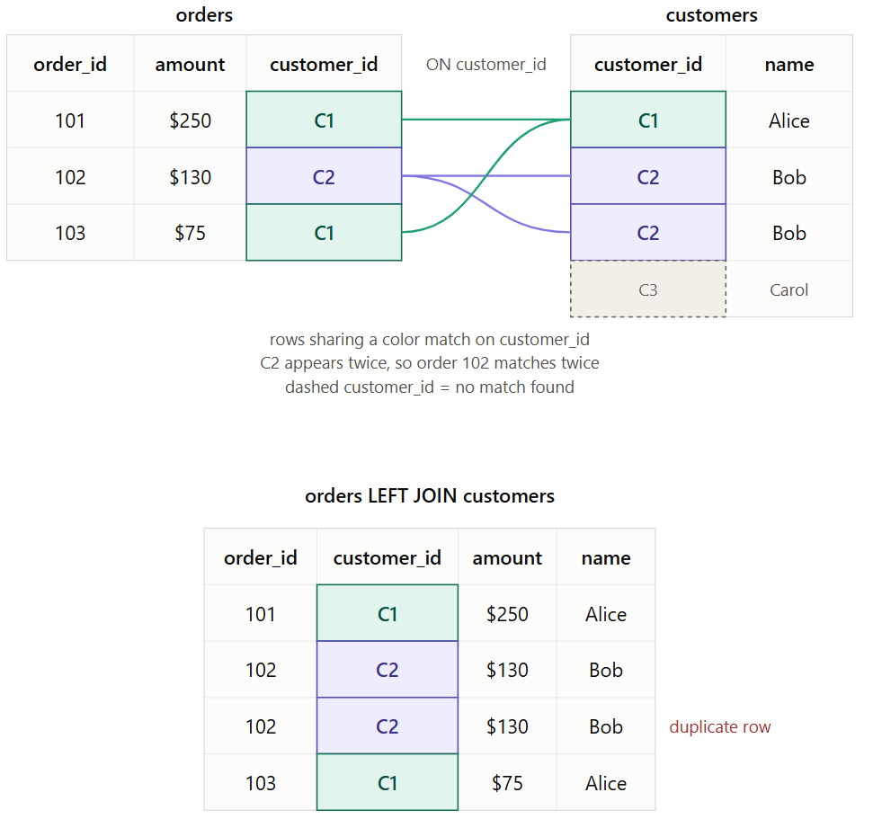
SQL BASICS
JOIN
SQL ESSENTIALS · DAY 1
28

Slide 30
SQL BASICS
JOIN Example
SELECT
a.entity_name,
SUM(t.amount_paid) AS total_paid
FROM transactions t
LEFT JOIN accounts a
ON t.from_bank_id = a.bank_id
AND t.from_account = a.account_number
GROUP BY a.entity_name
ORDER BY total_paid DESC
LIMIT 10;
-- fact table joined to a lookup table, then summarized -
-- one of the most common patterns you'll write
SQL ESSENTIALS · DAY 1
29

Slide 31
SQL BASICS
Types of JOIN
INNER JOIN
LEFT JOIN
RIGHT JOIN
FULL OUTER JOIN
only rows with a match in both tables
all rows from the left; unmatched right = NULL
mirror of LEFT
all rows from both, matched where possible
Compared to VLOOKUP: same idea (look up by a key) - but VLOOKUP always returns exactly one match. A JOIN can return zero, one, or many, depending on type.
SQL ESSENTIALS · DAY 1
30

Slide 32
PRACTICAL 4
JOIN Practice
WRITE
SELECT a.bank_name, a.entity_name, COUNT(*) AS laundering_txn_count
FROM transactions t
LEFT JOIN accounts a
ON t.from_bank = a.bank_id AND t.from_account = a.account_number
WHERE t.is_laundering = 1
GROUP BY a.bank_name, a.entity_name
ORDER BY laundering_txn_count DESC;
CHALLENGE
Try it grouped by entity_name only, instead of both columns — how does the ranking change?
SQL ESSENTIALS · DAY 1
31

Slide 33
PRACTICAL 4
JOIN Practice — By Bank Only
WRITE
SELECT a.bank_name, COUNT(*) AS laundering_txn_count
FROM transactions t
LEFT JOIN accounts a
ON t.from_bank = a.bank_id AND t.from_account = a.account_number
WHERE t.is_laundering = 1
GROUP BY a.bank_name
ORDER BY laundering_txn_count DESC;
CHALLENGE
Compare this ranking to the by-bank-and-entity version — which banks dominate either way?
SQL ESSENTIALS · DAY 1
32

Slide 34
SQL BASICS
The Dangers of JOIN
-- WRONG: joining on bank_id alone, forgetting account_number
SELECT COUNT(*)
FROM transactions t
LEFT JOIN accounts a
ON t.from_bank = a.bank_id;
-- every bank has many entities/accounts under it. drop
-- account_number from the join, and each transaction row
-- duplicates once per matching entity - row counts explode,
-- and any SUM on top gets overstated.
-- VLOOKUP always returns exactly one match. SQL JOIN can
-- silently multiply your rows.
SQL ESSENTIALS · DAY 1
33

Slide 35
SQL BASICS
The Dangers of JOIN (Part 2)
SELECT COUNT(*) FROM transactions; -- baseline
SELECT COUNT(*) FROM transactions t
LEFT JOIN accounts a ON t.from_bank = a.bank_id; -- much larger!
SELECT COUNT(*) FROM transactions t
LEFT JOIN accounts a
ON t.from_bank = a.bank_id
AND t.from_account = a.account_number; -- fixed
-- after every join, sanity-check the row count against
-- what you expected before trusting any aggregation on top
SQL ESSENTIALS · DAY 1
34

Slide 36
SQL INTERMEDIATE
Common Table Expressions (CTEs)
WITH large_txns AS (
SELECT * FROM transactions WHERE amount_paid > 10000
)
SELECT COUNT(*) FROM large_txns;
-- readability: name each step instead of nesting subqueries
-- reusability: reference the same CTE more than once
-- no cleanup: unlike a temp table, nothing to drop after
-- chainable: define several CTEs in sequence, each on the last
SQL ESSENTIALS · DAY 1
35

Slide 37
SQL INTERMEDIATE
CTE Example
WITH laundering_flagged AS (
SELECT from_bank_id, from_account, amount_paid, is_laundering
FROM transactions
WHERE is_laundering = 1
)
SELECT
from_bank_id,
COUNT(*) AS laundering_txns,
SUM(amount_paid) AS laundering_total
FROM laundering_flagged
GROUP BY from_bank_id
ORDER BY laundering_total DESC;
-- chain more CTEs by adding another “, name AS (...)" block
SQL ESSENTIALS · DAY 1
36

Slide 38
PRACTICAL 5
CTE Practice
Take the “percentage of laundering transactions by currency” query from Practical 3.
It's currently a flat query with CASE WHEN inside aggregates.
Restructure it using WITH so the flagging step and the percentage step are each their own named CTE.
CHALLENGE
Compare readability side by side with the original — which version would you rather debug at 5pm on a Thursday?
SQL ESSENTIALS · DAY 1
37

Slide 39
FRAUD DETECTION
Benford's Law
In naturally occurring numbers — transaction amounts, invoice totals, populations — the leading digit isn't evenly distributed. About 30% of values start with 1; only ~4.6% start with 9.
That's why it's a standard forensic-accounting check — and one you can run directly in SQL: group transaction amounts by their leading digit and compare the counts to the expected curve below. A flat or spiky distribution is a signal worth investigating, not proof of fraud on its own.
EXPECTED FREQUENCY OF THE LEADING DIGIT
30.1%
17.6%
12.5%
9.7%
7.9%
6.7%
5.8%
5.1%
4.6%
1
2
3
4
5
6
7
8
9
SQL ESSENTIALS · DAY 1
38

Slide 40
SQL ADVANCED (BONUS)
Self-Joins
SELECT t1.*, t2.*
FROM transactions t1
JOIN transactions t2
ON t1.to_account = t2.from_account
AND t1.to_bank = t2.from_bank_id;
-- a self-join joins a table to itself - treat it as two
-- separate "copies" using aliases (t1, t2)
-- useful for chains, hierarchies, and "find related rows"
-- aliasing is required - SQL can't tell the copies apart
SQL ESSENTIALS · DAY 1
39

Slide 41
SQL ADVANCED (BONUS)
Self-Join Example: Chain of Transactions
SELECT t1.from_account AS acct_a, t1.to_account AS acct_b,
t1.amount_paid AS amt_a_to_b, t1.Timestamp AS time_a_to_b,
t2.to_account AS acct_c, t2.amount_paid AS amt_b_to_c,
t2.Timestamp AS time_b_to_c
FROM transactions t1
JOIN transactions t2
ON t1.to_account = t2.from_account
AND t1.to_bank = t2.from_bank
WHERE t2.Timestamp > t1.Timestamp
AND t1.is_laundering = 1 AND t2.is_laundering = 1
ORDER BY t1.Timestamp
LIMIT 20;
-- A -> B -> C: money moves, then moves on quickly - a classic
-- "layering" pattern; self-joins fan out easily too (slide 34)
SQL ESSENTIALS · DAY 1
40

Slide 42
DAY 1 RECAP
What We Covered
SQL fundamentals — SELECT, WHERE, GROUP BY, aggregates
CASE WHEN — flagging and bucketing data
JOIN — combining tables, and the mistakes that quietly corrupt results
CTEs — writing multi-step queries that read cleanly
Bonus: self-joins — tracing a chain of transactions
Bridge: Day 2 — Python builds on this same transaction data.
Thank you — Questions?
SQL ESSENTIALS · DAY 1
41

Slide 43
FILE LOADING
Loading Multiple Files into the Database
Real risk data doesn't arrive as one clean file — it's a folder of monthly CSV and Excel exports from different source systems.
Someone still has to open every file, check the columns line up, and load it somewhere queryable.
Automating that with glob + DuckDB turns a recurring manual chore into a few lines of code, run the same way every month.
SQL ESSENTIALS · DAY 1
42

Slide 44
FILE LOADING
Finding Files with glob
import glob
glob.glob("data/*.csv")
# ['data/jan_transactions.csv', 'data/feb_transactions.csv', ...]
glob.glob("data/**/*.xlsx", recursive=True)
# matches .xlsx files in data/ and any subfolder
# * matches any characters; ** + recursive=True searches subfolders
SQL ESSENTIALS · DAY 1
43

Slide 45
FILE LOADING
Loading CSVs into DuckDB
import duckdb
con = duckdb.connect()
# DuckDB accepts a glob pattern directly - no Python loop needed
con.sql("""
CREATE OR REPLACE TABLE transactions AS
SELECT * FROM read_csv_auto('data/*.csv')
""")
# one call ingests every matching CSV in the folder
Note: if you have the csv pattern stored in a variable csv_pattern, you can use:
Select * from read_csv_auto({csv_pattern})
SQL ESSENTIALS · DAY 1
44

Slide 46
FILE LOADING
Loading Excel + Persisting to a Database
import glob, pandas as pd, duckdb
# DuckDB can't glob-read Excel directly - loop with pandas
con = duckdb.connect("risk.duckdb") # file on disk, not memory
for path in glob.glob("data/*.xlsx"):
df = pd.read_excel(path)
con.sql("INSERT INTO transactions SELECT * FROM df")
# connect("risk.duckdb") -> data survives after the script ends
SQL ESSENTIALS · DAY 1
45

Slide 47
PRACTICAL 4
Load a Folder of CSVs
WRITE
import duckdb
def load_csv_folder(folder_path, db_path="risk.duckdb"):
con = duckdb.connect(db_path)
con.sql(f"""
CREATE OR REPLACE TABLE transactions AS
SELECT * FROM read_csv_auto('{folder_path}/*.csv')
""")
return con
CHALLENGE
Add a print statement that reports how many rows landed in the table after loading.
SQL ESSENTIALS · DAY 1
46

Slide 48
PRACTICAL 4
Add the Excel Files
WRITE
import glob, pandas as pd
def load_excel_folder(folder_path, con):
for path in glob.glob(f"{folder_path}/*.xlsx"):
df = pd.read_excel(path)
con.sql("INSERT INTO transactions SELECT * FROM df")
con = load_csv_folder("data")
load_excel_folder("data", con)
CHALLENGE
What happens if an Excel file's columns are in a different order than the CSVs? Test it and see. Then commit and push io.py - you should be getting the hang of this by now.
SQL ESSENTIALS · DAY 1
47

